Slide 1
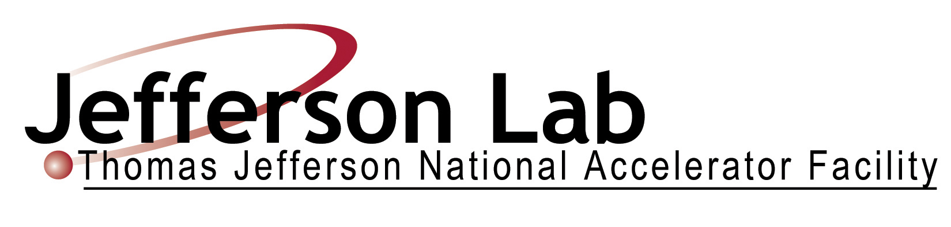
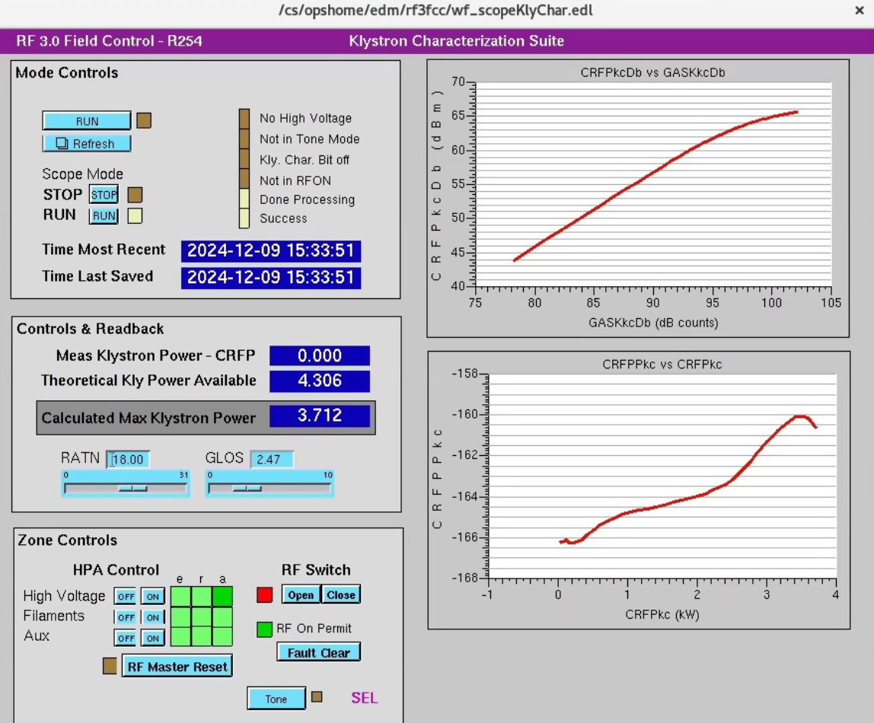
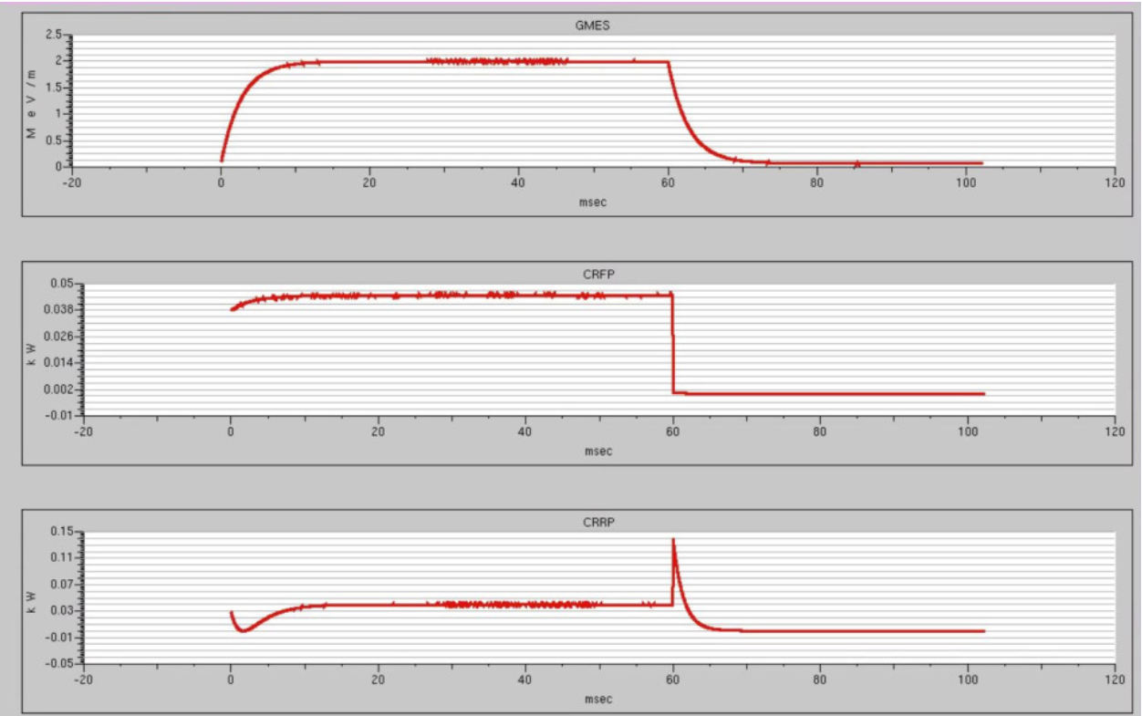
LLRF COMMISSIONING OF THE CEBAF C75 UPGRADES, SAM 2024/2025 *
M. Geesaman†, J. K. Tiskumara, R. Bachimanchi, K. Hesse, S. Higgins, K. Jyamfi, J. Latshaw, C. Mounts,
T. Plawski, J. Settle
Thomas Jefferson National Accelerator Facility, Newport News, Virginia, U.S.A.
ABSTRACT
During Jefferson Lab’s Scheduled Accelerator Maintenance (SAM) in 2024, two C75 cryomodules were installed in CEBAF with JLab’s Low Level RF (LLRF) 3.0 digital control system. Three key processes of JLab’s LLRF commissioning include completing Interlock verification, klystron characterization, and cavity characterization. This paper summarizes the preparation, automation and commissioning efforts for the new cryomodule installation and controls checkout.
New C75 Cryomodules
During the 2024 SAM, two cryomodules with C20 type cavities in the CEBAF accelerator were replaced by new C75 style refurbished cryomodules.
The C75 cavities are 5 Cell cavities manufactured by Research Instruments (RI) , GmbH in Germany with an operational accelerating gradient (𝐸acc) of 19.1 MV/m and a quality factor (𝑄o) of at least 8 × 10⁹ at a temperature of 2.07 K (helium pressure of 29 ±0.1 Torr) [1].
The cavities were assembled and tested as pairs in the Vertical Test Area (VTA) prior to being assembled in a cryomodule. After assembly, the cryomodules were tested in the Cryomodule Test Facility (CMTF) to determine the operational conditions (maximum gradient, Field emission) before installation in the LINAC [1].
One of the cryomodules was plasma processed because of the high field emission detected during these tests [1]. These cryomodules were installed in the North LINAC (1L09) and South LINAC (2L05).
High Power installations
Pre-Commissioning - Part 2: Testing Cavities
Cavity interlocks , stepper motor settings and low power commissioning.
Interlocks were verified to ensure that a fault opens the RF switch when a fault occurs.
Waveguide window (sits between the cold cavity, held under vacuum, and the pressurized waveguide), temperature interlock, cavity waveguide and beamline vacuum interlocks, Arc detector (protect ceramic windows in the input waveguides from damage caused by electrical arcs) interlocks and helium level interlock were tested.
The fiber connections were checked to ensure the signal from FSD to the machine protection system is working and the signals are propagating to the FSD multi tree.
Prior to tuning the cavities to machine frequency, the tuner settings are configured (stepper limits, stepper current, etc.).
RF power of less than 100 watts is applied to each cavity and cavity detune frequency is measured.
Each cavity is then tuned to the machine frequency.
The existing instrumentation and connections were removed from the selected zones so that new components could be installed.
The CPS and MDP breakers were replaced with higher current circuit breakers.
The transformer, choke, contactor, diode stack, HV wiring, and HV capacitor were replaced.
A SCR was installed to allow the voltage in the zone to be adjusted electronically.
Pre-Commissioning - Part 3: Cavity setup for operations
SRF commences the next phase of commissioning - this includes determining the operational conditions of the cavities and cryomodule in their installed configuration.
The measured external quality factors (Qext), intrinsic quality factors (Q0) and the stored energy (accelerating gradient) of the cavity are stored in JLab's CEBAF Element Database (CED) to record the final cavity configuration for operations.
Once the operational gradients were determined by SRF, automatic cavity characterizations are performed to confirm the Qext values, the optimal loop gains are entered and then the cavities are operated in SELAP mode for beam operations.
Table 01: Maximum Klystron powers from klystron characterization and External Quality factors from cavity characterization.
LLRF Commissioning
These C75 cryomodules are controlled by JLab’s LLRF 3.0 digital control systems which were developed to replace the legacy LLRF Systems in the CEBAF accelerator [2,3].
These systems utilize the Self Excited Loop Amplitude and Phase (SELAP) algorithm for cavity control – a fully functional phase and amplitude locked Self Excited Loop [2,3].
The FCCs were installed along with the heater, HPA, interlock, and stepper motor chassis and their power supplies as a part of the upgrade.
The heater, arc, IR, probe, and stepper cables are connected to the cryomodule.
Gains, coupling factors, and losses from components both inside and outside of FCCs are measured and each FCC has their in-situ external calibrations performed.
Pre-Commissioning - Part 1: Testing into Shorts
The first test was with shorting plates installed on the waveguides so that the high-power systems may be checked out without applying any power into the cavities.
RF was applied to generate < 100 watts of power and the Klystron Reflected Power (KRRP) readback was monitored to verify the corresponding KRRP interlock, which removes the RF drive to the Klystron to prevent damage.
All the klystrons/FCCs were checked to ensure the forward and reflected power measurements were similar in EPICS and then verified by measuring the signals with an independent power meter.
Klystron characterizations were performed to ensure the klystron is behaving as expected and that it is not being driven into saturation.
This test enables a mapping between the FCC GASK to the power measured by a coupler downstream of isolator.
Characterization involves ramping the drive power from minimum to maximum for a very short time interval with a single fixed frequency (tone) while the cavity forward power magnitude and phase are measured.
All klystrons showed a theoretical klystron power ~5 kW.
Once the numbers in these initial tests were within the expected range, the waveguides were then connected to the cavities (which were cooled to 2K).
Cavity | 1L09 |  | 2L05
 | Max kly. Power (kW) | Qext (X10⁷) | Max kly. Power (kW) | Qext (X10⁷)
1 | 5.15 | 2.7 | 5.65 | 1.2
2 | 4.75 | 2.9 | 5.90 | 1.5
3 | 5.22 | 1.7 | 5.78 | 1.8
4 | Bypassed |  | 5.51 | 1.4
5 | 5.00 | 1.3 | 4.76 | 1.6
6 | 5.18 | 1.2 | 5.42 | 1.7
7 | 4.90 | 1.7 | 4.95 | 2.6
8 | 5.18 | 1.8 | 5.26 | 2.1
Inside of a Fast DAQ Chassis
Summary and Future Plans
Two of the zones in CEBAF were upgraded with new C75 cryomodules and related LLRF 3.0 digital control systems. The upgrades included LLRF commissioning both before and after connecting the cavities to the waveguides. Both cryomodules are now operational, and we are currently procuring and building additional LLRF 3.0 systems to upgrade six more zones over the next several years.
Figure 01: Klystron characterization screen (left) and characteristic waveform screens from cavity characterization (right).
References
[1] I. Senevirathne et al., “Commissioning results of third C75 cryomodule for CEBAF”, in Proc. IPAC’24, Nashville, USA. May 2024, pp188-18.
https://doi.org/10.18429/JACoW-IPAC2024-MOPC55
[2] T.E. Plawski et al., “JLAB LLRF 3.0 Development and Tests” in Proc. IPAC’21, Campinas, SP, Brazil, May 2021, pp. 4340-4342.
doi:10.18429/JACoW-IPAC2021-THPAB271
[3] T.E. Plawski et al., “First SELAP algorithm operational experience of the new LLRF 3.0 RF control System” in Proc. LINAC’22, Liverpool, UK, Aug-Sep 2022,pp. 795-797.
doi:10.18429/JACoW-LINAC2022-THPOPA24
[4] T. Plawski et al., Low Level Radio Frequency Field Control Chassis (LLRF FCC) Version 3.0 document revision 1.4.
*Authored by JSA, LLC under U.S. DOE Contract DE-AC05- 06OR23177 and DE-SC0005264. The U.S. Govt. retains a non-exclusive, paid-up, irrevocable, world-wide license to publish or reproduce this for U.S. Govt. purposes.
† email: geesaman@jlab.org

